Slide 1

Exploration of COVID-19 Cases Peaks and Growth in
California and New York

Slide 2
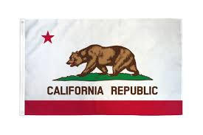

Peaks in Overall cases and Daily cases?
Focus our forecasts on:
California and New York State
Los Angeles and New York City
Notes:
We examined the peak number of COVID-19 cases in the state of California and New York. Additionally, we also examined Los Angeles and New York City. We estimated the peak by forecasting the number of COVID-19 cases. We chose these states and cities because they are two of examples of states and cities most affected by the recent pandemic. Understanding the peak is useful for understanding how much our healthcare systems will be strained. Additionally, understanding the peak allows for examining when states should ease up on protective measures and reopening the economy.

Slide 3

Data Characteristics
Retrieved from New York Times Github
Data is daily and consists of cumulative cases as of that day
Derive the daily cases and growth from these cumulative cases
Data is between March 1, 2020 to April 11, 2020
Notes:
https://github.com/nytimes/covid-19-data
As of this report, we retrieved the data up to April 11, 2020. We retrieved our COVID-19 data from the New York Times. We clean the data up using SQL. The data is daily and consists of cumulative cases as of that day. We derive the daily cases and growth from these cumulative cases. Starting in March 2020, most states began having significant amounts of COVID-19 cases. Because the data is in a relatively short period of March 1st to April 11, forecasting is particularly challenging here.

Slide 4
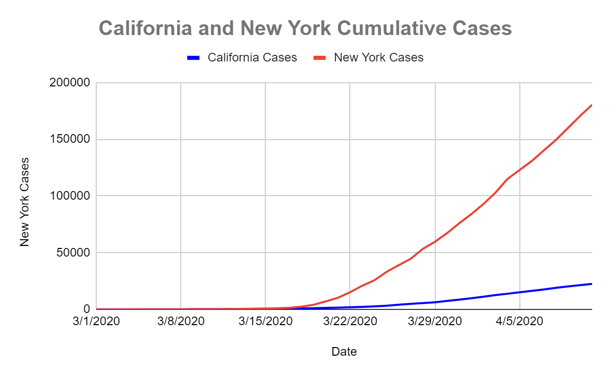
California and New York
Notes:
As of April 11, 2020, California currently accumulated 22,421 cases while New York accumulated 180,458 cases. New York currently has the highest number of COVID-19 cases compared to other states by a wide margin. The shape of the cumulative cases is curvilinear. The growth could either rampen up significantly or slow down, depending on government intervention.

Slide 5
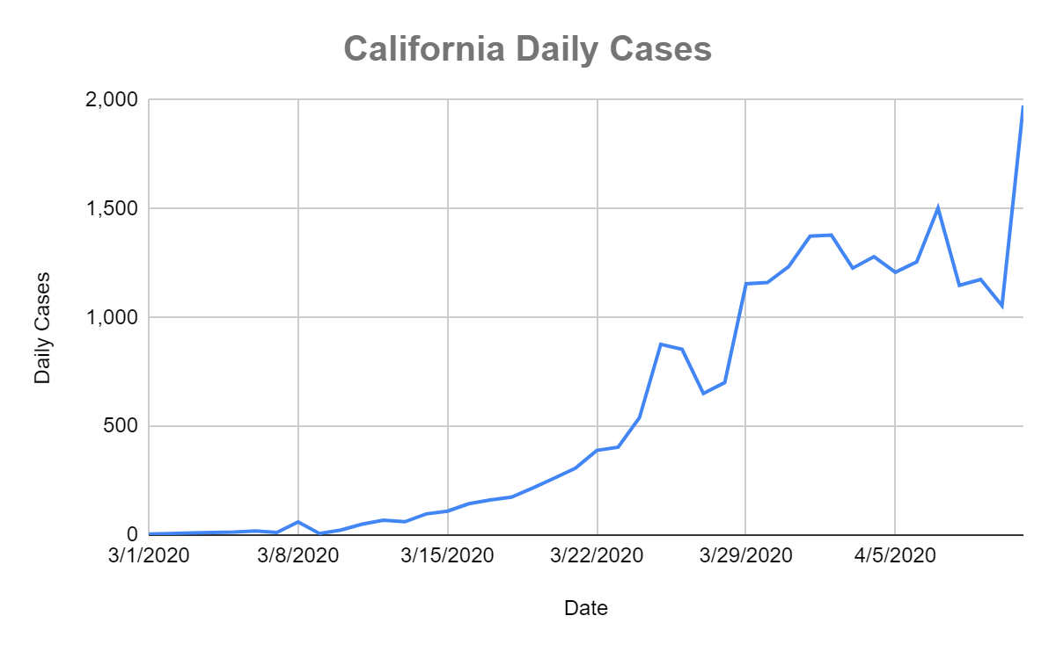
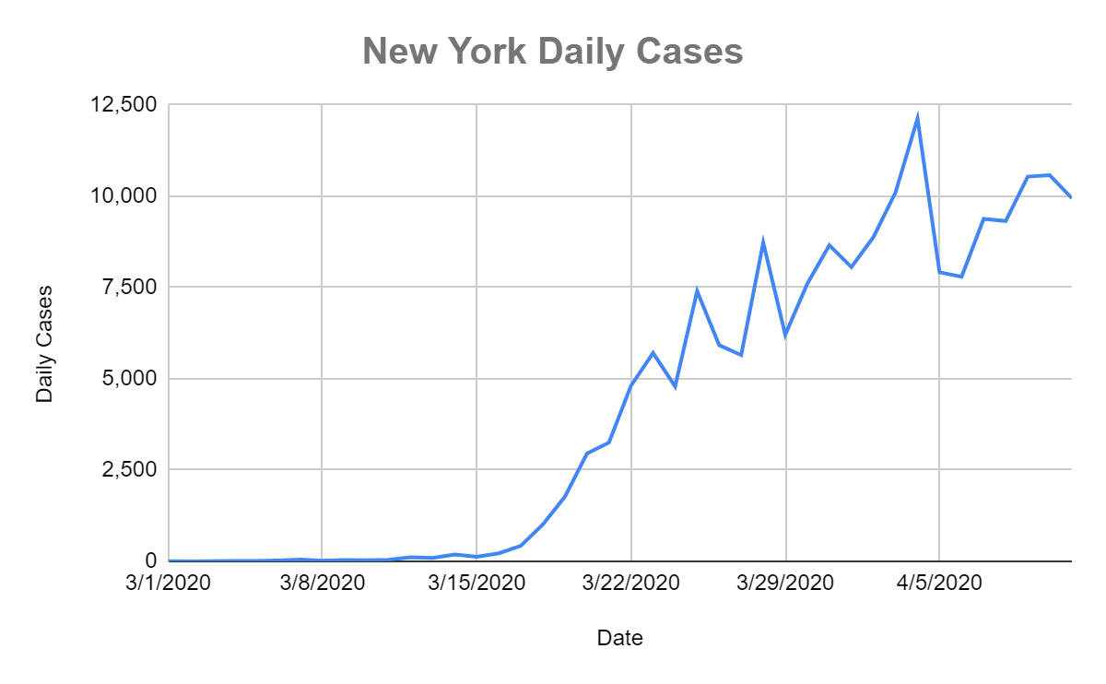
California and New York
Notes:
As of April 11, 2020, California cases peaked at 1,975 and New York cases peaked at 12,126. Both appear to be trending upwards.

Slide 6
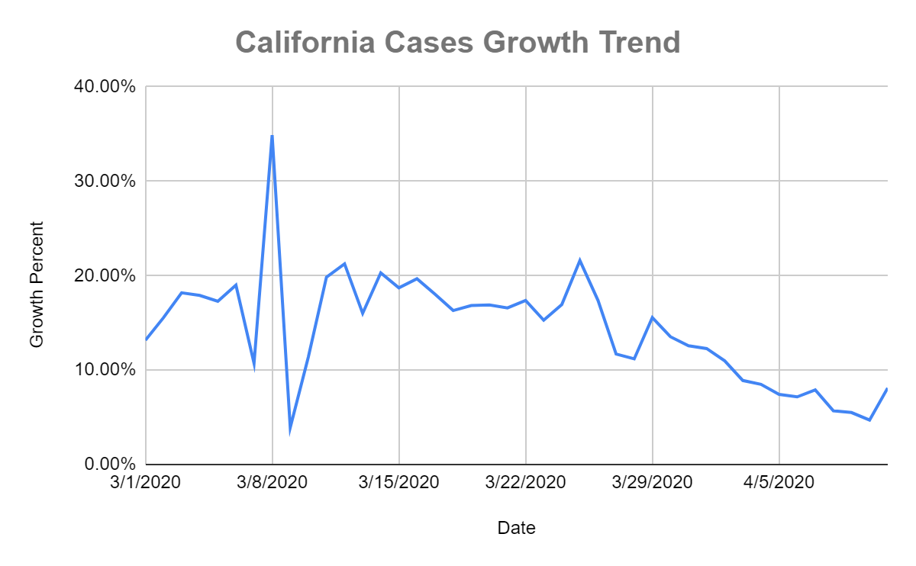
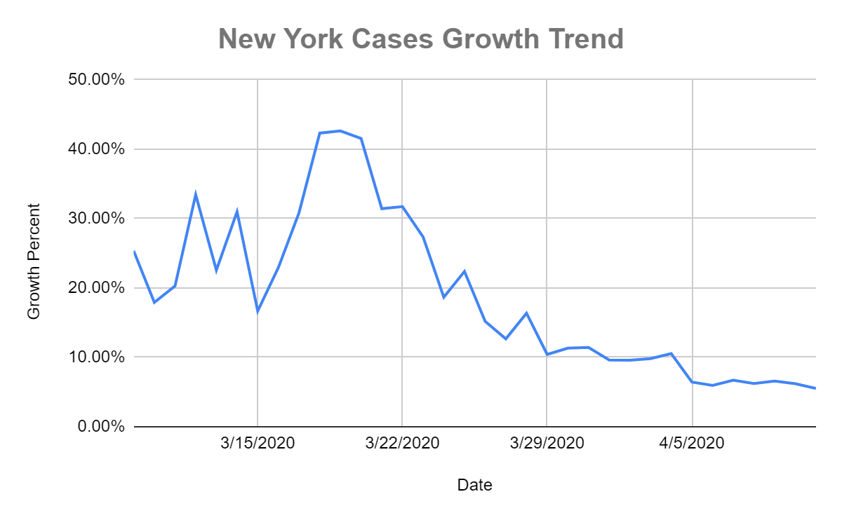
California and New York
Notes:
In terms of growth, the number of cases has large growth early on, but appears to trend downward as time moves on.

Slide 7
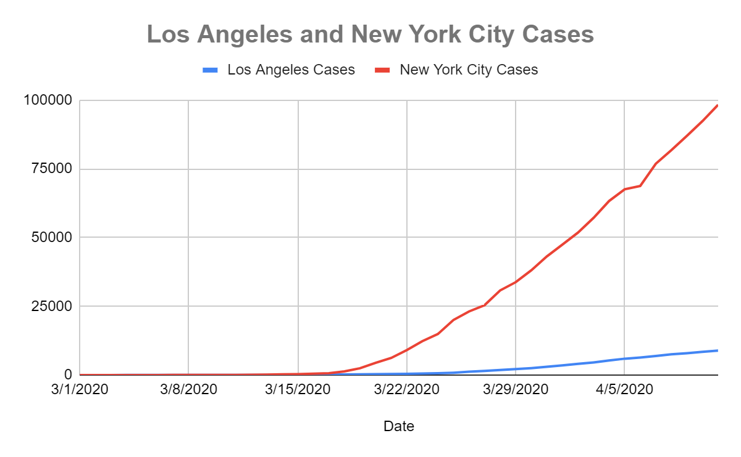
Los Angeles and New York City
Notes:
We examine these two cities within California and New York, as they contribute greatly to their state’s COVID-19 cases. Similar to states, we have a curvilinear trend with Los Angeles and New York City. As of April 11, 2020, Los Angeles accumulated 8,873 cases and New York City accumulated 98,308 cases.

Slide 8
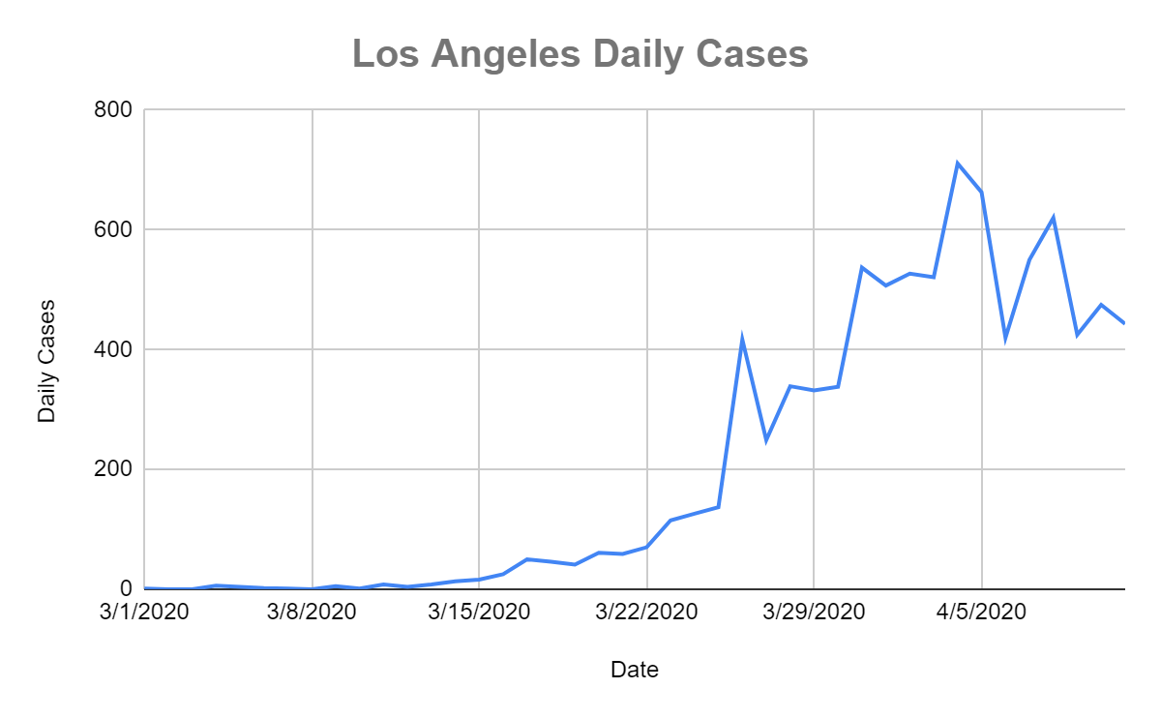
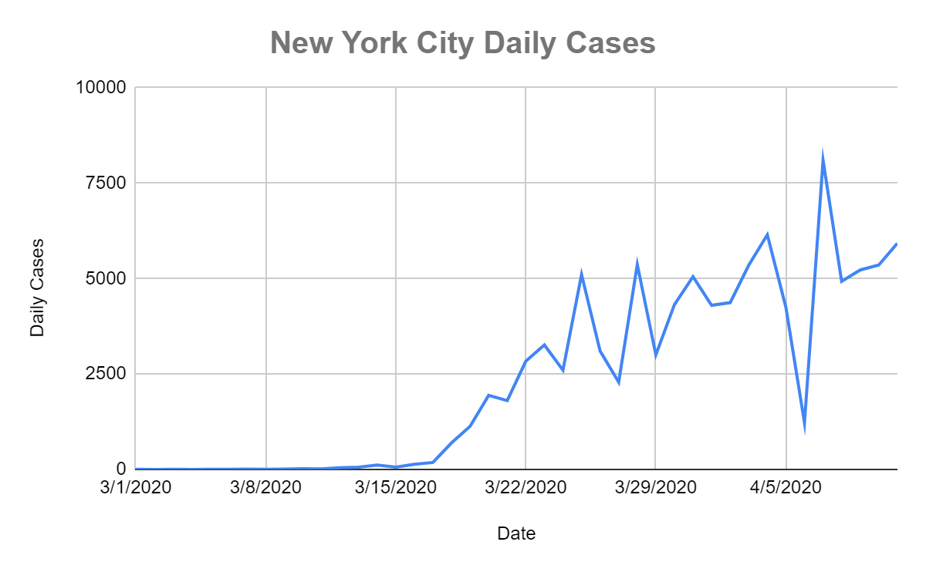
Los Angeles and New York City
Notes:
As of April 11, 2020, Los Angeles cases peaked at 711 and New York City cases peaked at 8,100. Both appear to be trending upwards.

Slide 9
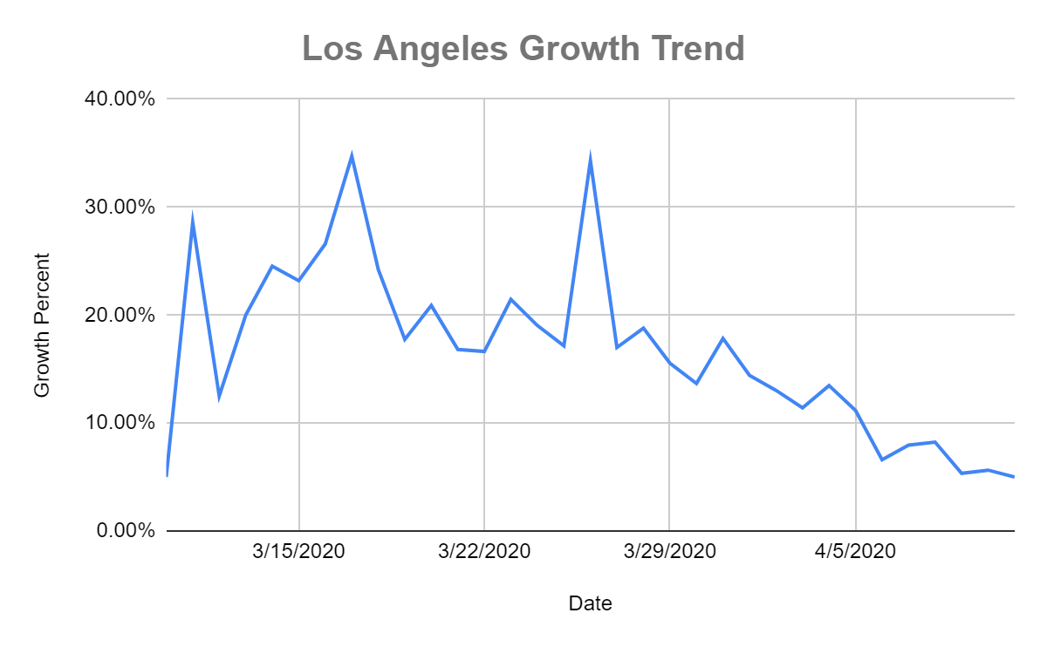
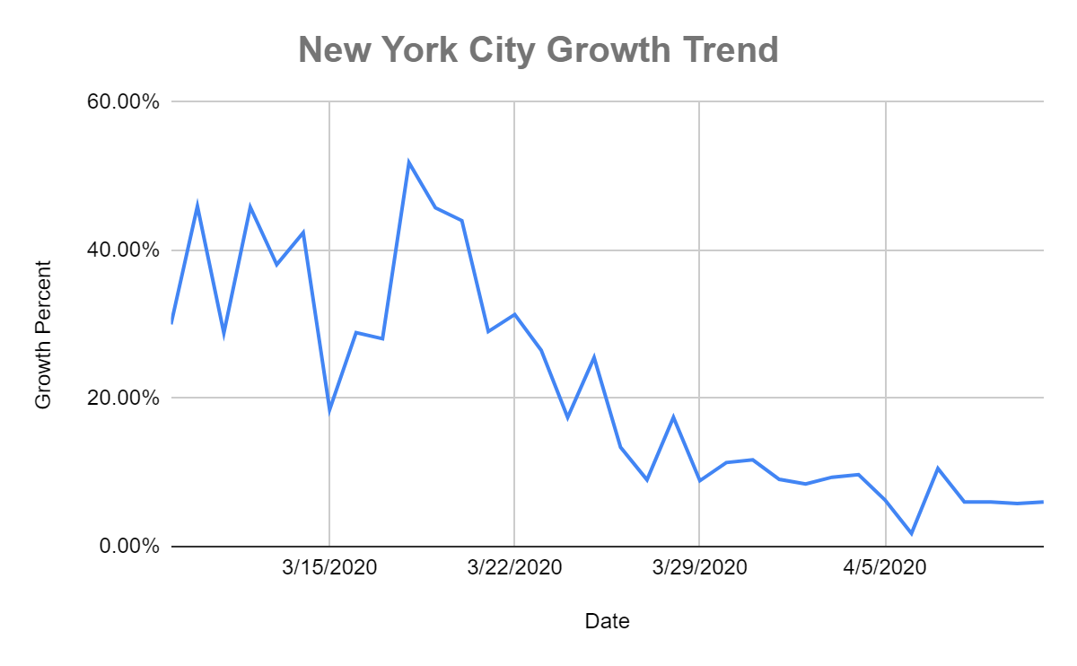
Los Angeles and New York City
Notes:
Similar to states, the number of cases has large growth early on, but appears to trend downward as time moves on.

Slide 10
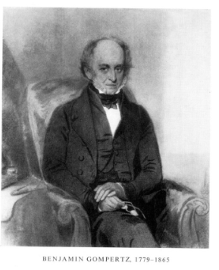


Model Selection
We chose the Gompertz Model to model potential S-Curve
Where: a = carrying capacity
b = displacement on X-Axis
c = growth rate
Notes:
Given the curvilinear trend of the cumulative cases and how infection cases tamper off, we ultimately decided to rely on S-curve. Specifically, we decided on the Gompertz Model over other S-curve options. This model has more accurate forecasting if the capacity and growth can be estimated.
We developed a way to estimate this capacity. We found that Italy is a potential model for estimating capacity. Italy’s response to the Pandemic has been similar to the United States, in that it has a delayed response and a series of ramping up measures during the pandemic.
For growth rate, we examine various news sources regarding California and New York. We based our growth rate on the following information: (1) California Governor Gavin Newsom’s beliefs of a mid-May peak in California; and (2) current news that New York state and New York City may be close to turning the corner. Our model creation process is laid out in the appendices.
https://www.usnews.com/news/best-states/california/articles/2020-04-06/california-governor-sticking-with-mid-may-as-covid-19-peak
https://fivethirtyeight.com/features/new-york-coronavirus-curve/

Slide 11








Created Models for Forecasting
California: Cumulative Cases =
New York: Cumulative Cases =
Los Angeles: Cumulative Cases =
New York City: Cumulative Cases =
Notes:
All our models have R-Squared around .9992 (California R-Squared = .9992; New York R-Squared = .9994, Los Angeles R-Squared = .9992; New York City R-Squared = .9989).
We use these models for forecasting.

Slide 12
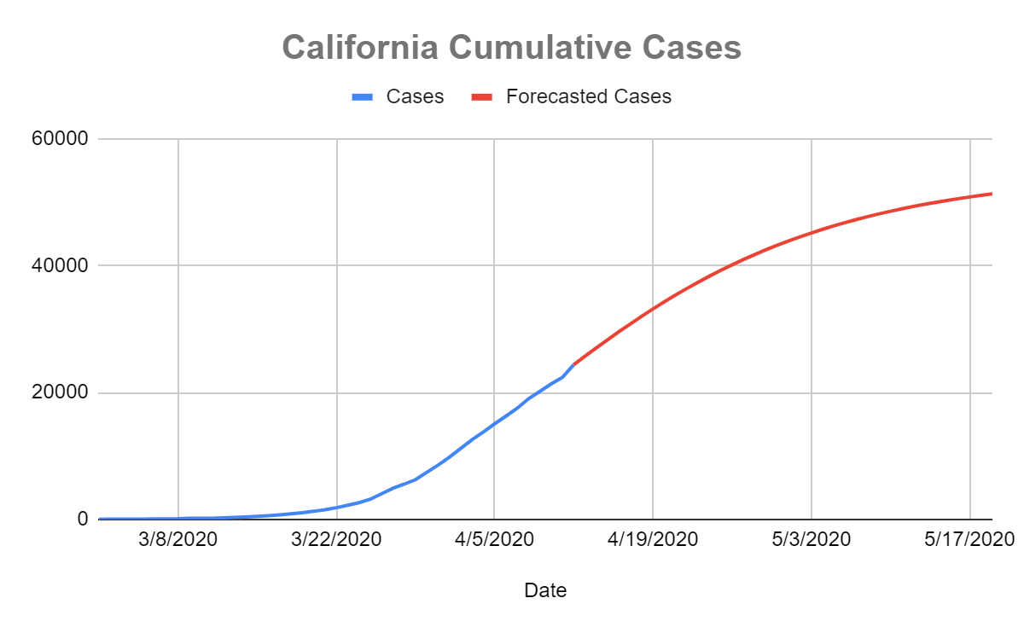
California Forecasts
Date | Forecasted Cases
5/15/2020 | 50,271
5/16/2020 | 50,552
5/17/2020 | 50,816
5/18/2020 | 51,063
5/19/2020 | 51,296
Notes:
Given our capacity and growth parameters, we forecasted peaks through May 19, 2020 for the two states and cities. Our given growth rate shows the cumulative cases approaches it peaks in mid-May.After forecasting the cumulative cases, we derive forecasts for daily cases and growth. At this peak, forecast the peak to be around 51,296 COVID-19 cases in California.

Slide 13
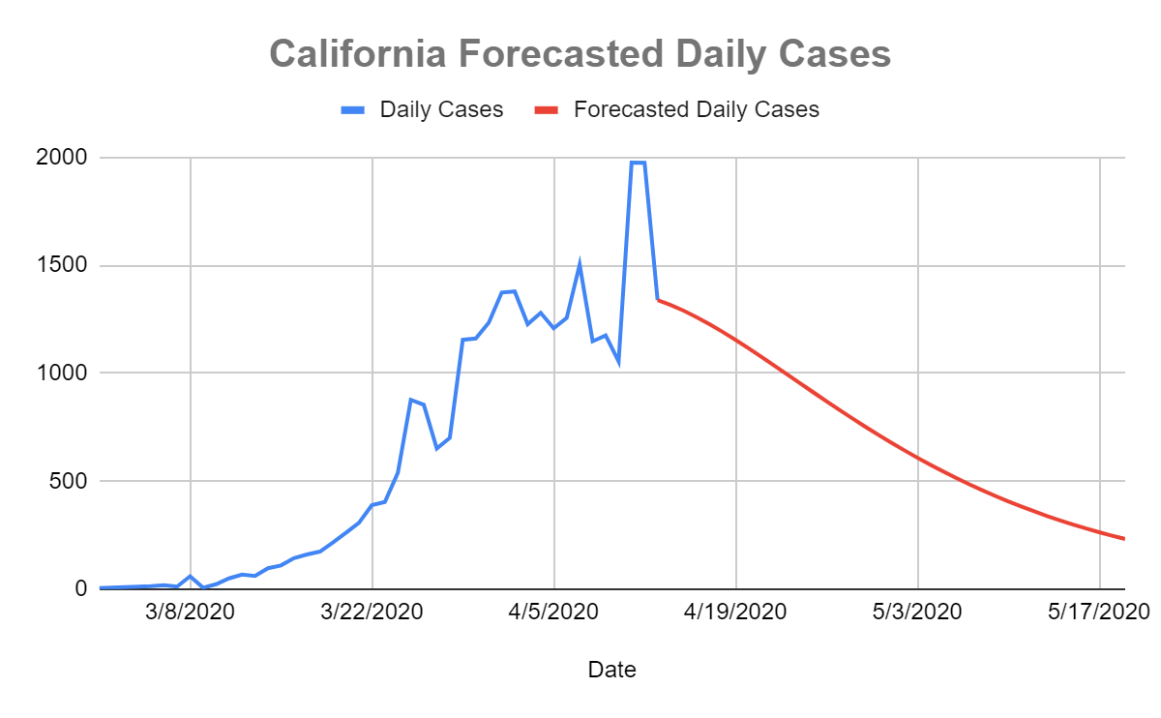
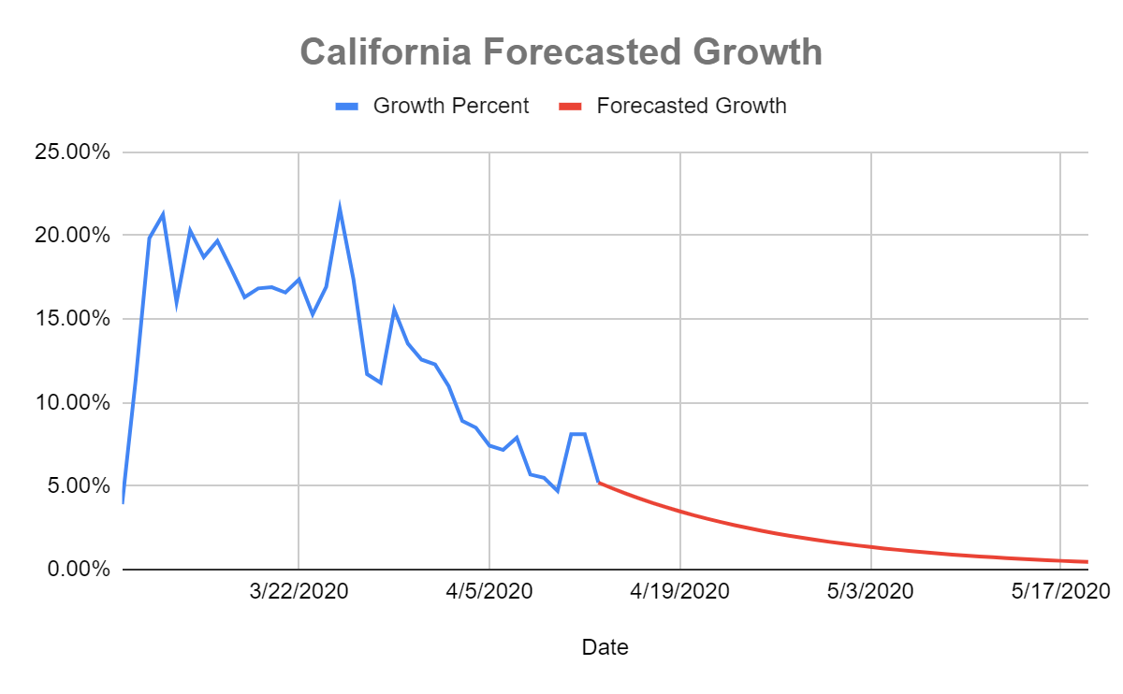
California Forecast
Notes:
For California, the number of daily cases starts trending downwards while the growth continues to trend downwards.

Slide 14
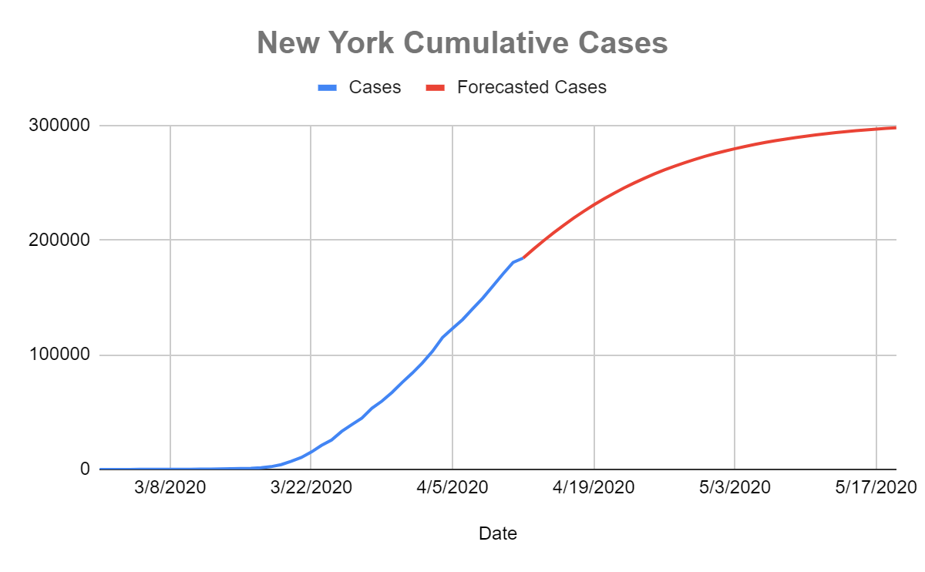
New York Forecasts
Date | Forecasted Cases
5/15/2020 | 295,265
5/16/2020 | 296,005
5/17/2020 | 296,687
5/18/2020 | 297,315
5/19/2020 | 297,894
Notes:
For New York, we forecast the peak to be around 297,894 COVID-19 cases.

Slide 15
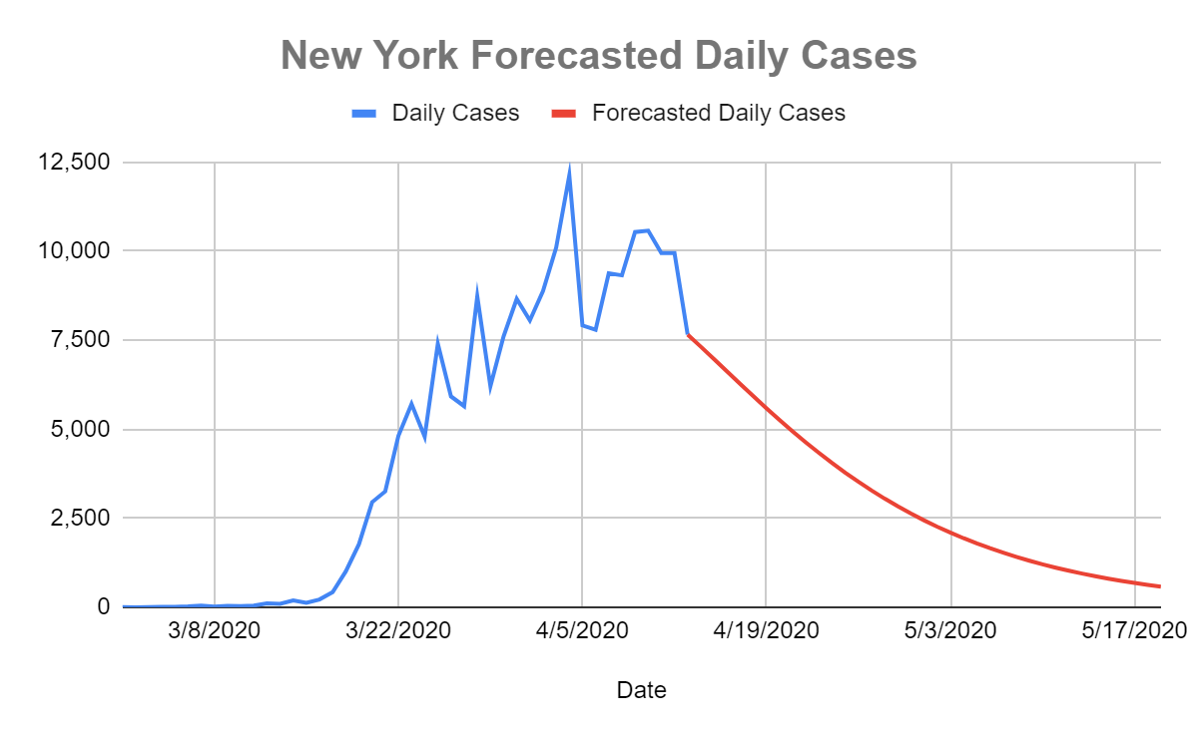
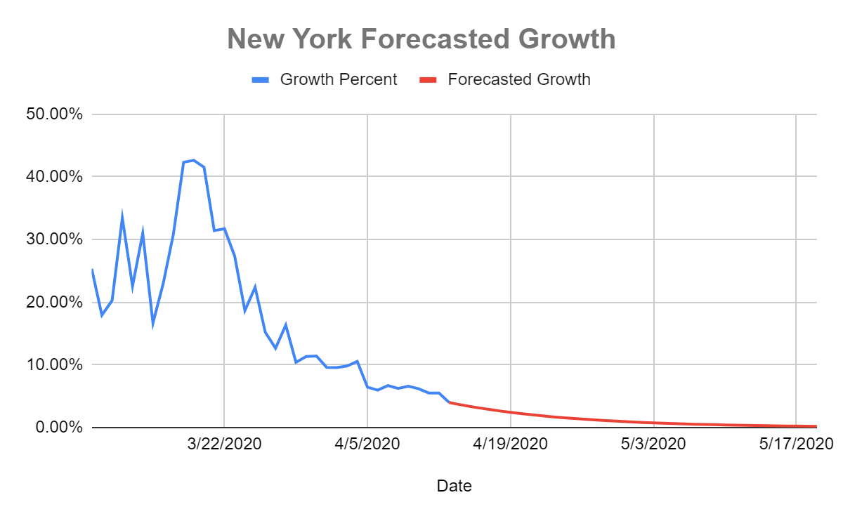
New York Forecasts
Notes:
Additionally, the number of daily cases starts trending downwards while the growth continues to trend downwards.

Slide 16
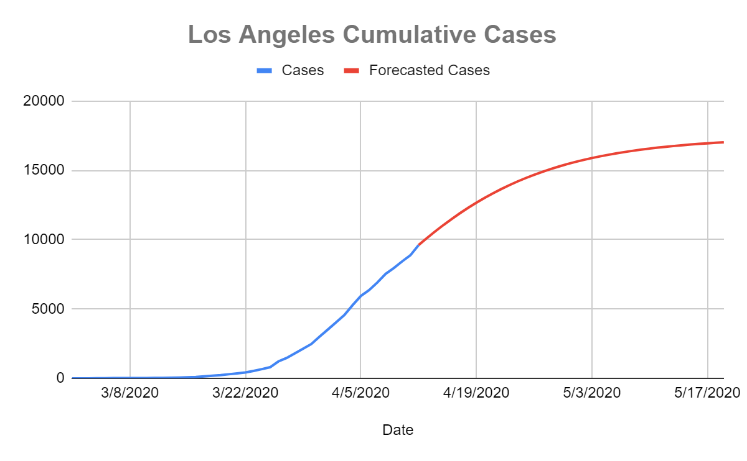
Los Angeles Forecasts
Date | Forecasted Cases
5/15/2020 | 16,862
5/16/2020 | 16,907
5/17/2020 | 16,948
5/18/2020 | 16,986
5/19/2020 | 17,020
Notes:
For Los Angeles, we forecast the peak to be around 17,020 COVID-19 cases.

Slide 17
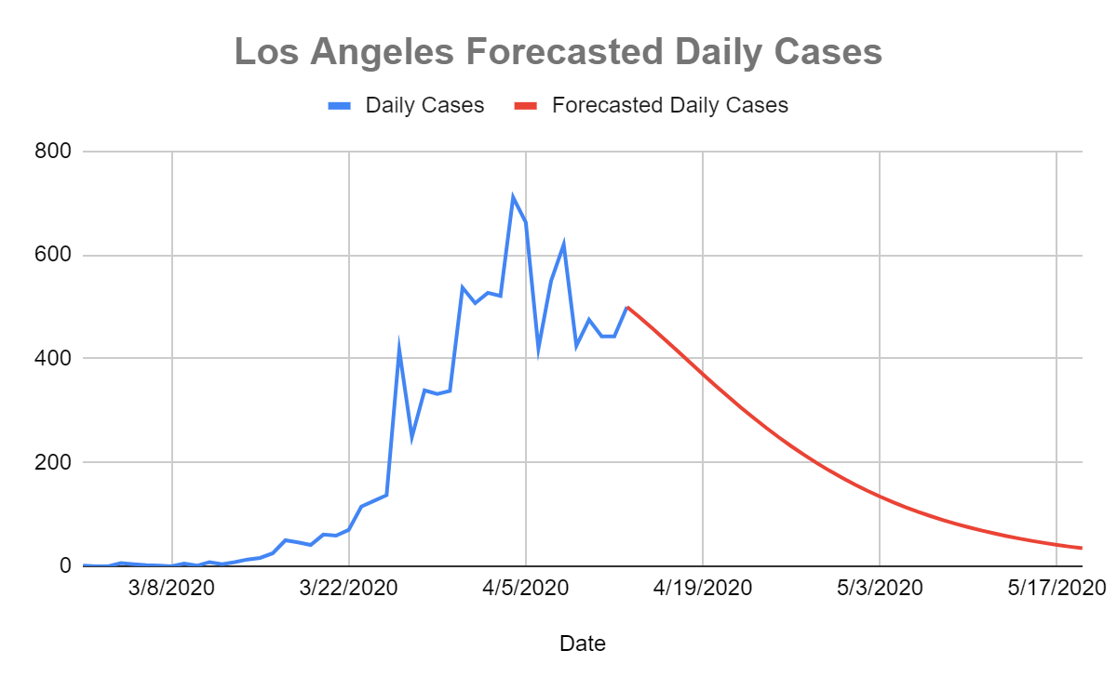
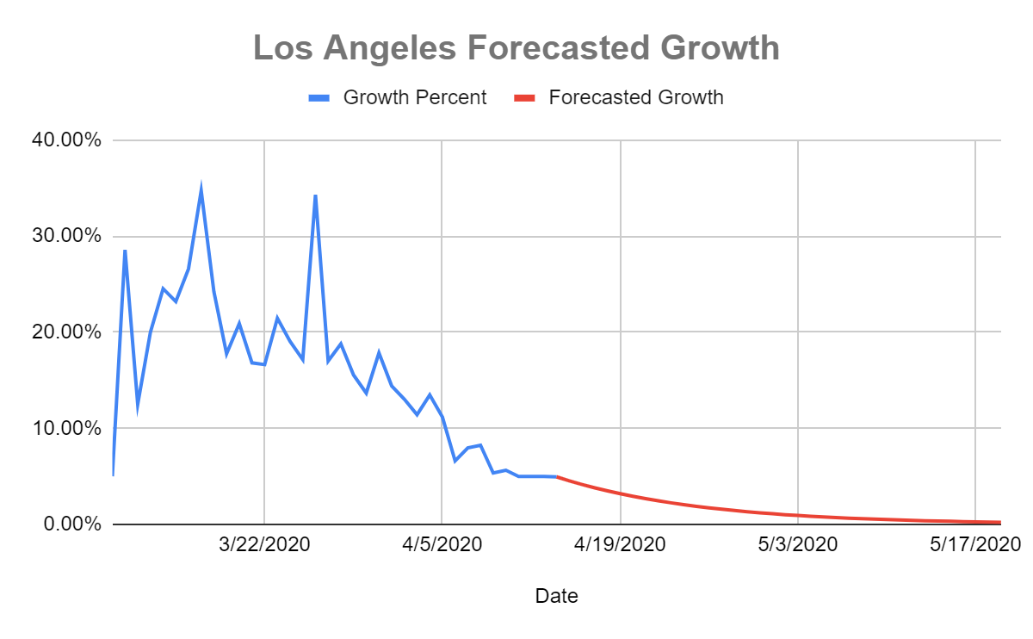
Los Angeles Forecasts
Notes:
Additionally, the number of daily cases starts trending downwards while the growth continues to trend downwards.

Slide 18
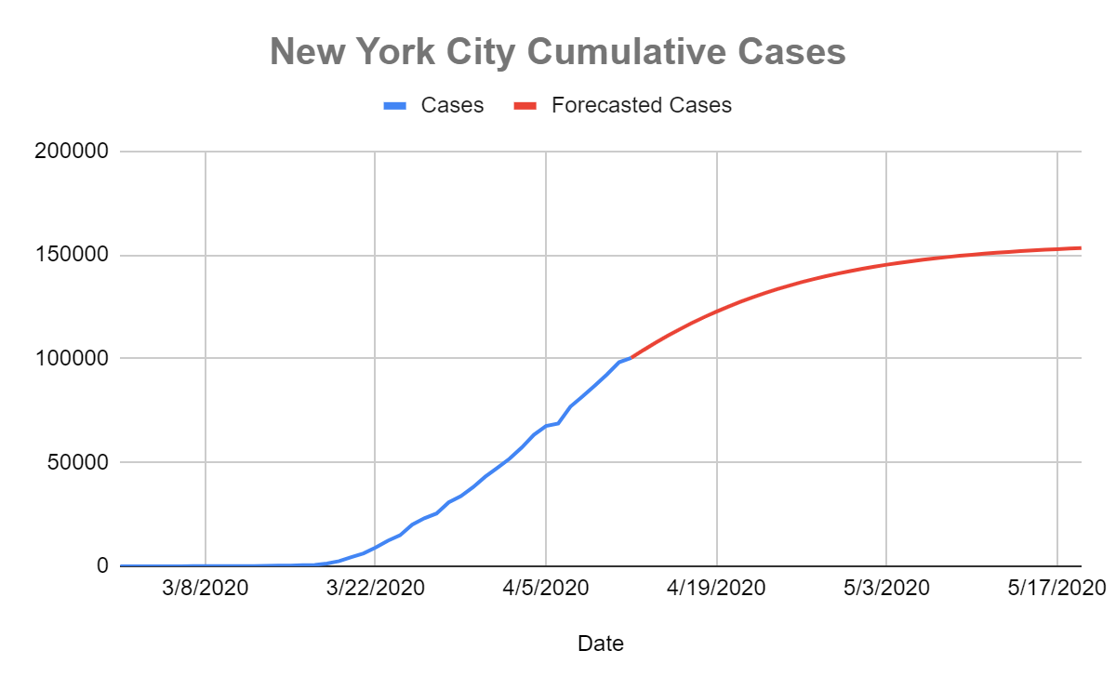
New York City Forecasts
Date | Forecasted Cases
5/15/2020 | 152,193
5/16/2020 | 152,514
5/17/2020 | 152,809
5/18/2020 | 153,081
5/19/2020 | 153,330
Notes:
Finally, for New York City, we forecast the peak to be around 153,330 COVID-19 cases.

Slide 19
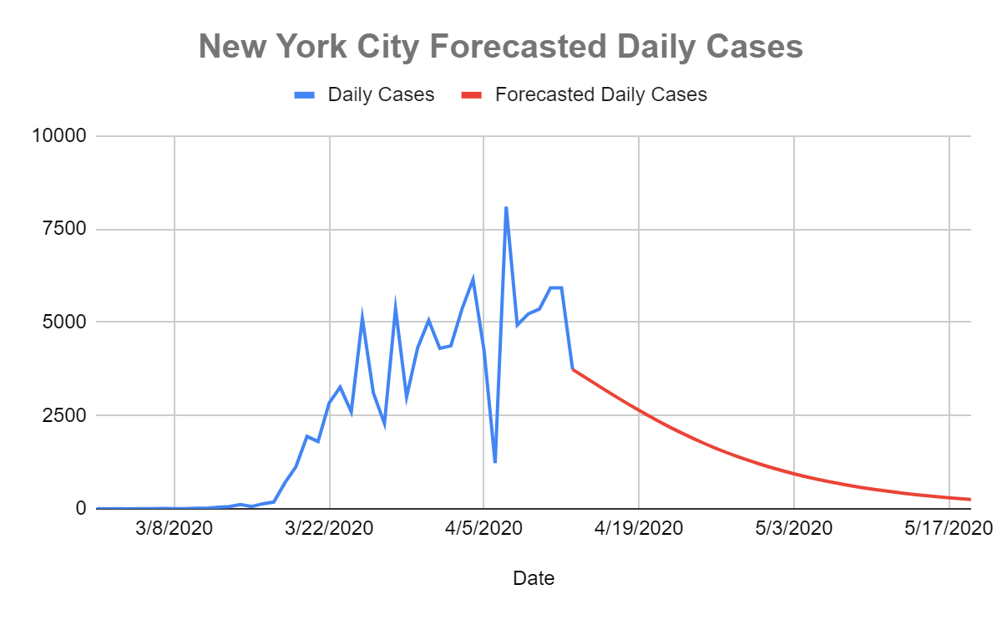
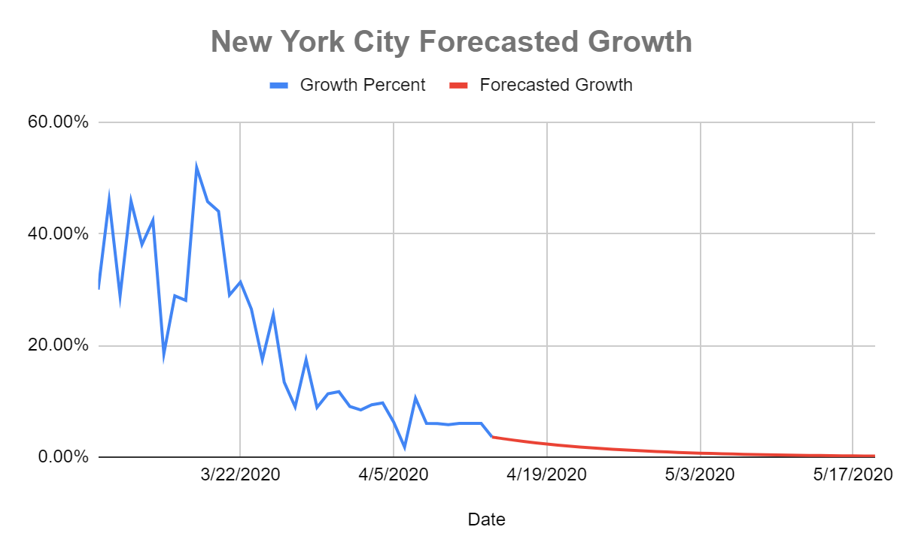
New York City Forecasts
Notes:
Additionally, the number of daily cases starts trending downwards while the growth continues to trend downwards.

Slide 20
Conclusion
- If protective measures continue, we forecast daily cases and growth will trend downwards
- Strain on healthcare systems may ease up in mid-May, potential time for limited reopening of state economies
- Main assumption: Protective measures continue
State | Forecasted Peak
California | 51,296
New York | 297,894
City | Forecasted Peak
Los Angeles | 17,020
New York City | 153,330

